Slide 1
Fraser Professional Learning
Essential #5 – Explicit Instruction in letter-sound Relationships – Related to Word Work/Word Study
May Manna Bethany Tabacchi

Slide 2
Welcome and Agenda
Welcome
Review of Dr. Anderson’s Beginning of the Year Expectations
Article to Anchor Learning
Essential #5 – Explicit Instruction in Letter-Sound Relationships
          Phases of word recognition
          Letter-Sound Development
          Word Study/Spelling Stages
          High-Frequency Words
          Instruction in Letter/Sound Relationships
          Spelling Inventory Practice
          Word Study/Word Work Planning
Review of Fraser’s previous professional learning with Word Study/Word Work
Time to Explore Resources and Plan

Slide 3

What is included in my Balanced Literacy block each day?
A quality Balanced Literacy Block will Include daily time (min. 120 minutes) for students in:
Shared Reading
Guided Reading/Small Group (based on level OR strategy)
Word work (Words Their Way)
Vocabulary
Interactive Read Aloud
Independent reading
Centers/stations/Daily 5

Slide 4




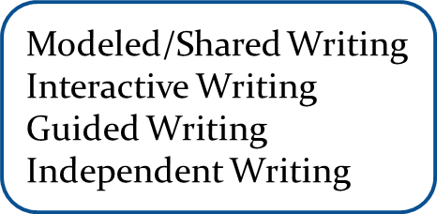

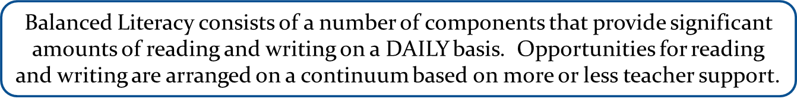
Balanced Literacy Framework

Slide 5
What literacy skills are explicitly taught?
A comprehensive Balanced Literacy Classroom will have learning opportunities focused on all of these areas:
Phonemic awareness
Phonics
Comprehension
Vocabulary/Word work
Fluency

Slide 6
Vocabulary/Word Work
Words Their Way - digital and/or paper form
Move away from Weekly Spelling lists
Application of letter/sound skills and sight word mastery can be evidenced in dictation activities (rather than a memorized list)
Word Sorts –dry erase boards – focusing on morphological awareness
Focus on sight words, patterns, vocabulary words depending on student’s level

Slide 7
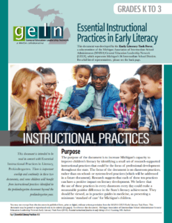


Resources for teachers
PreK-12 Literacy Framework
Essential Instructional Practices in Early Literacy
https://literacyessentials.org
Fraser Curriculum Weebly- frasercurriculum.com
**PreK-12 Indicators of High Quality Literacy Instruction**

Slide 8

Anchoring our Learning
Please read the article – Traditional Spelling Lists: Old Habits are Hard to Break
  by Katherine Hilden and Jennifer Jones
Please be prepared to discuss

Slide 9

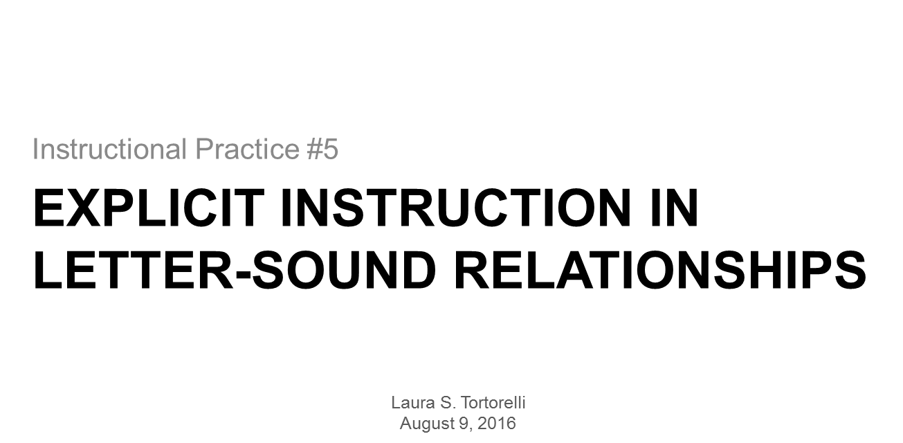
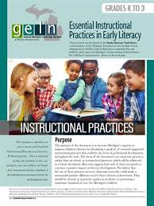
Explicit Instruction in Letter-Sound Relationships

Slide 10


Slide 11
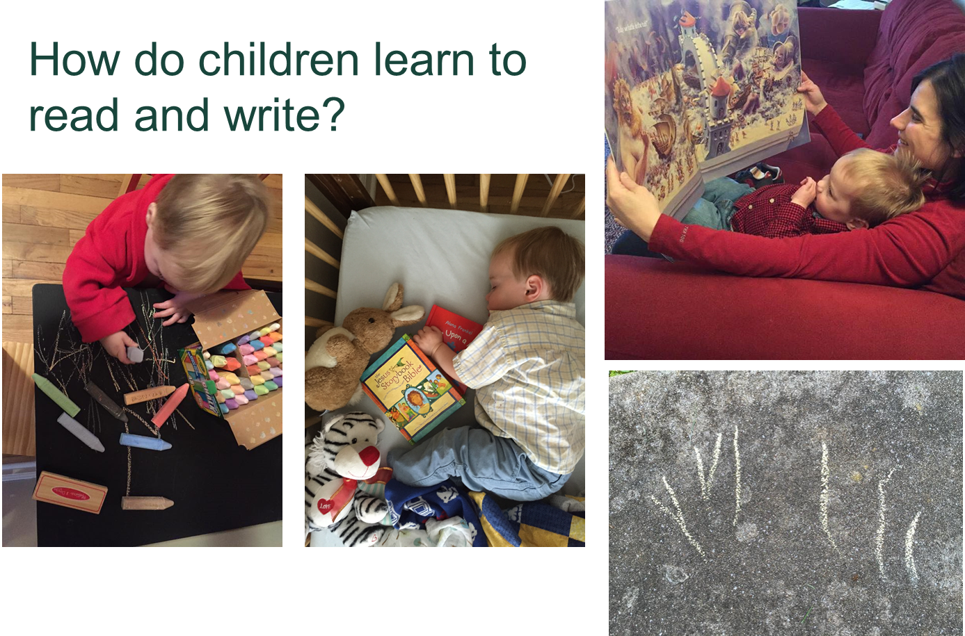

Slide 12
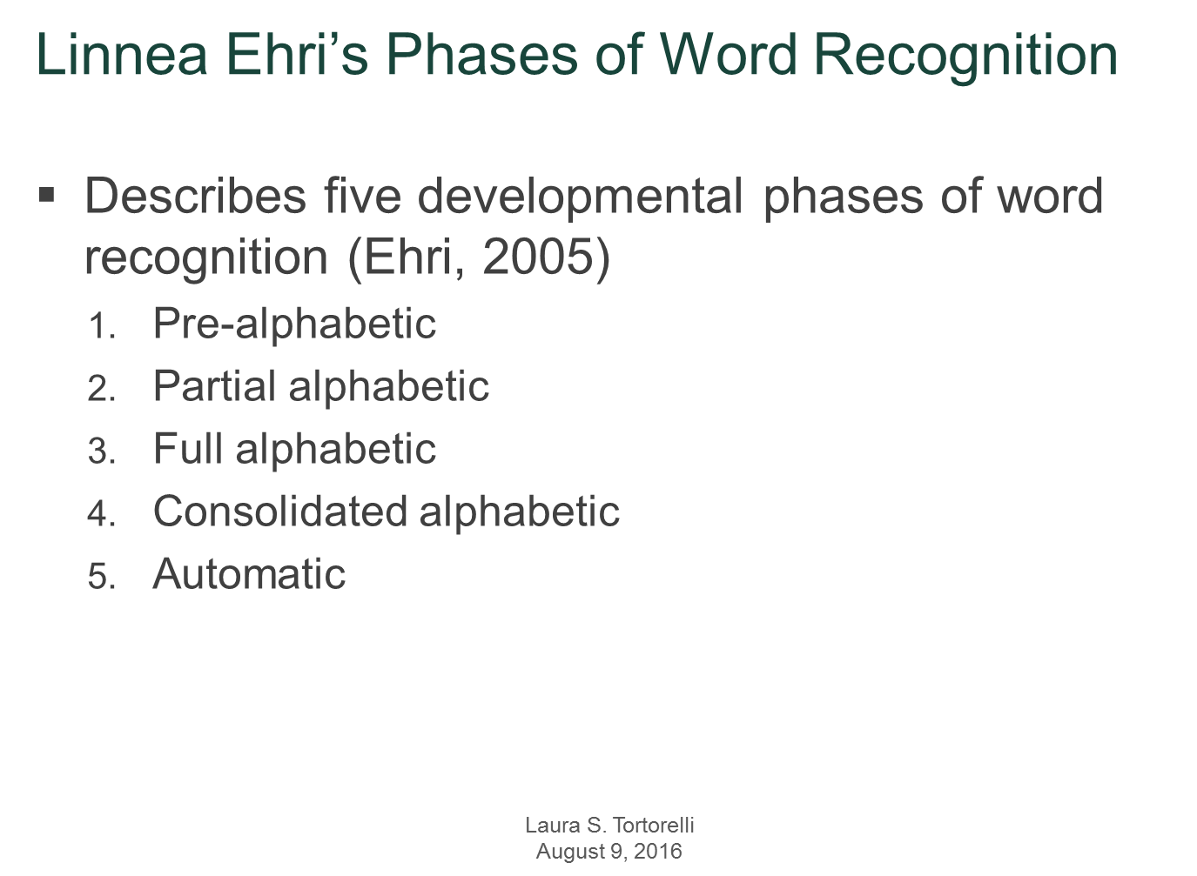

Slide 13
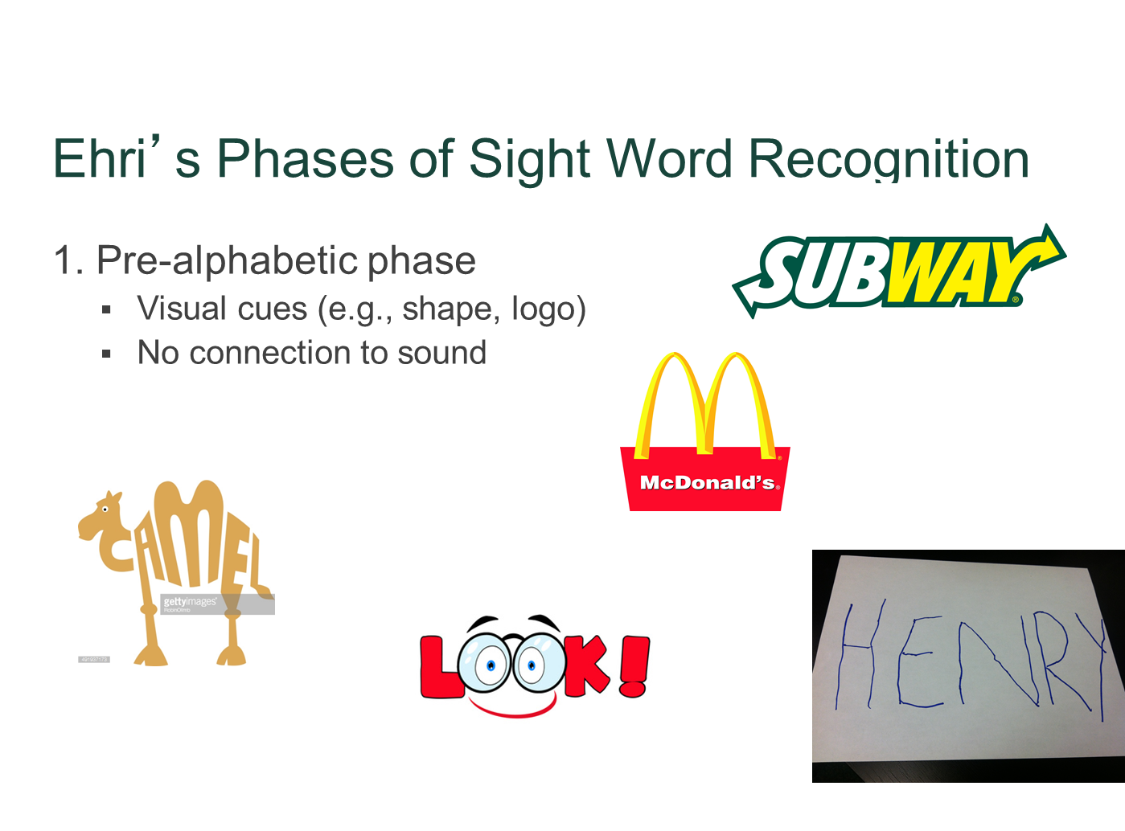

Slide 14
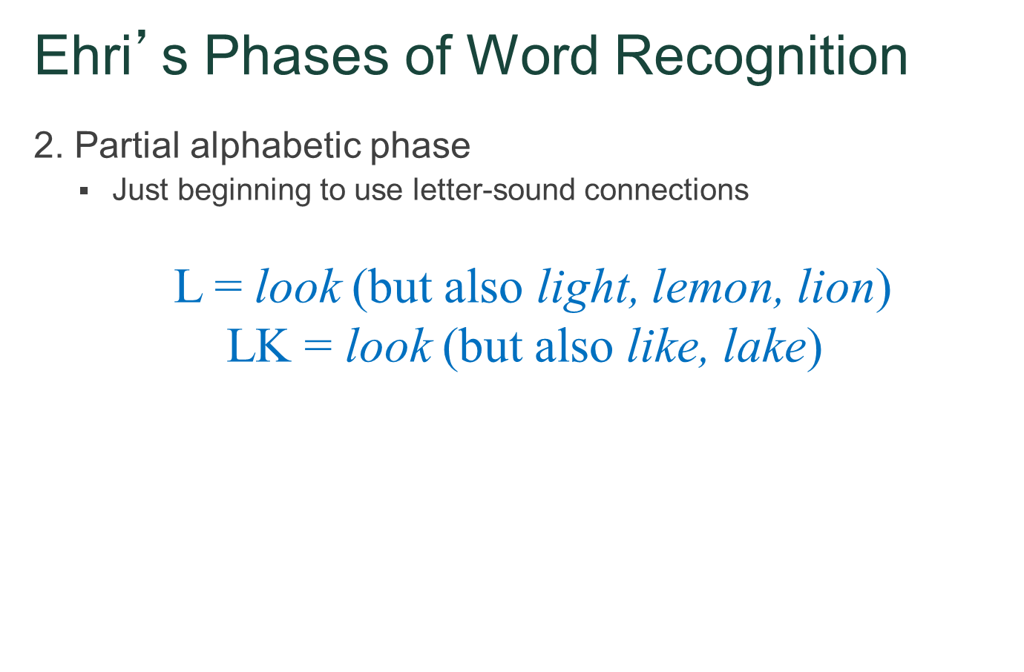

Slide 15
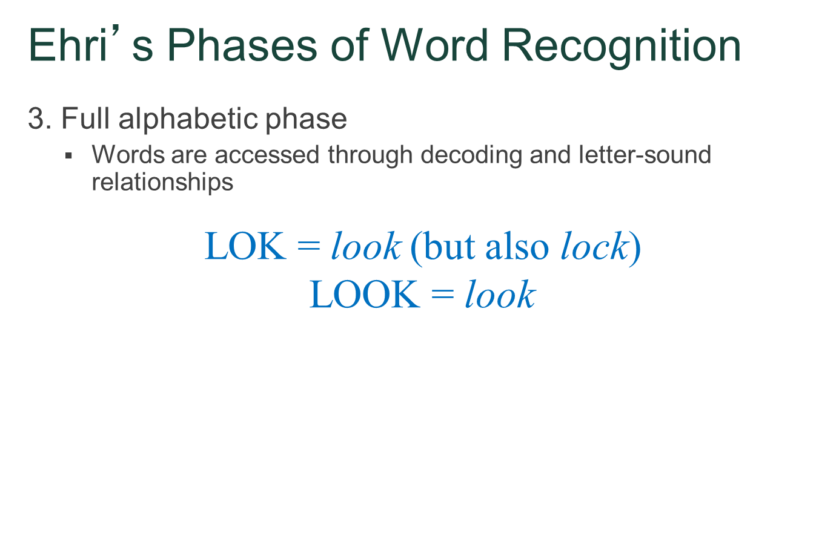

Slide 16
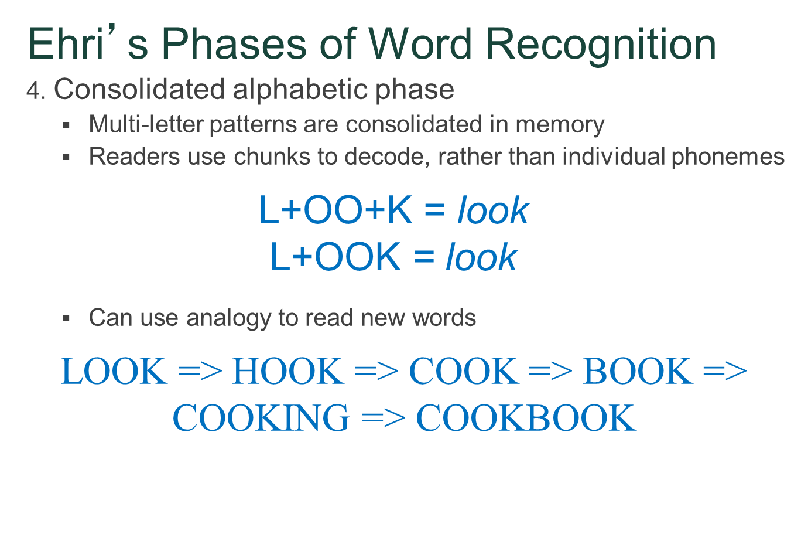

Slide 17
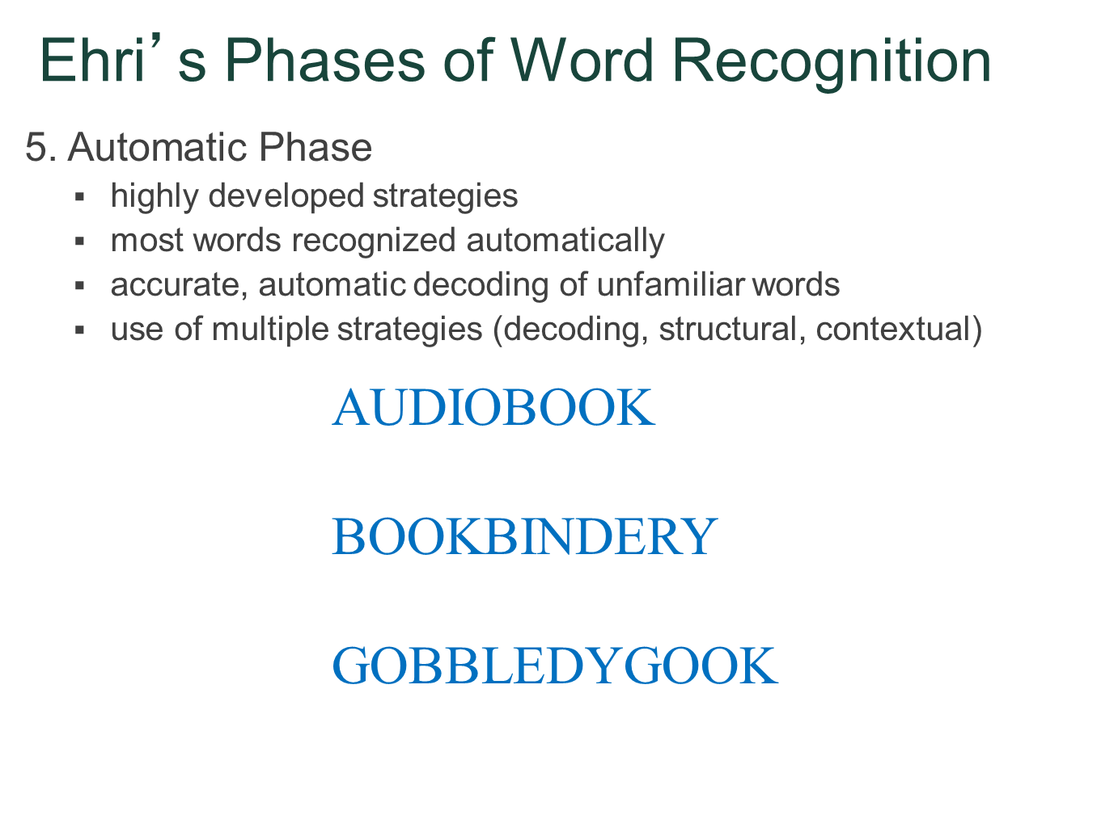

Slide 18
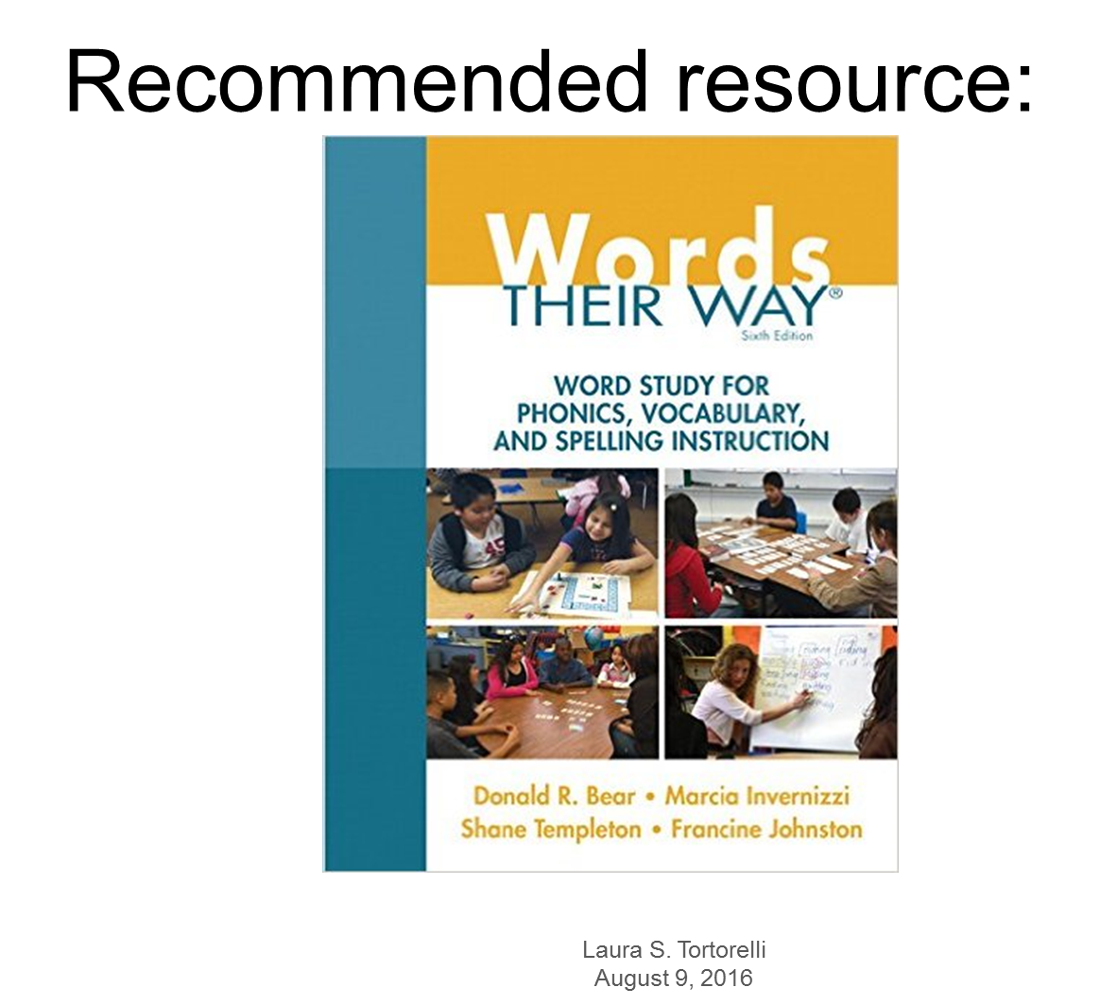

Slide 19
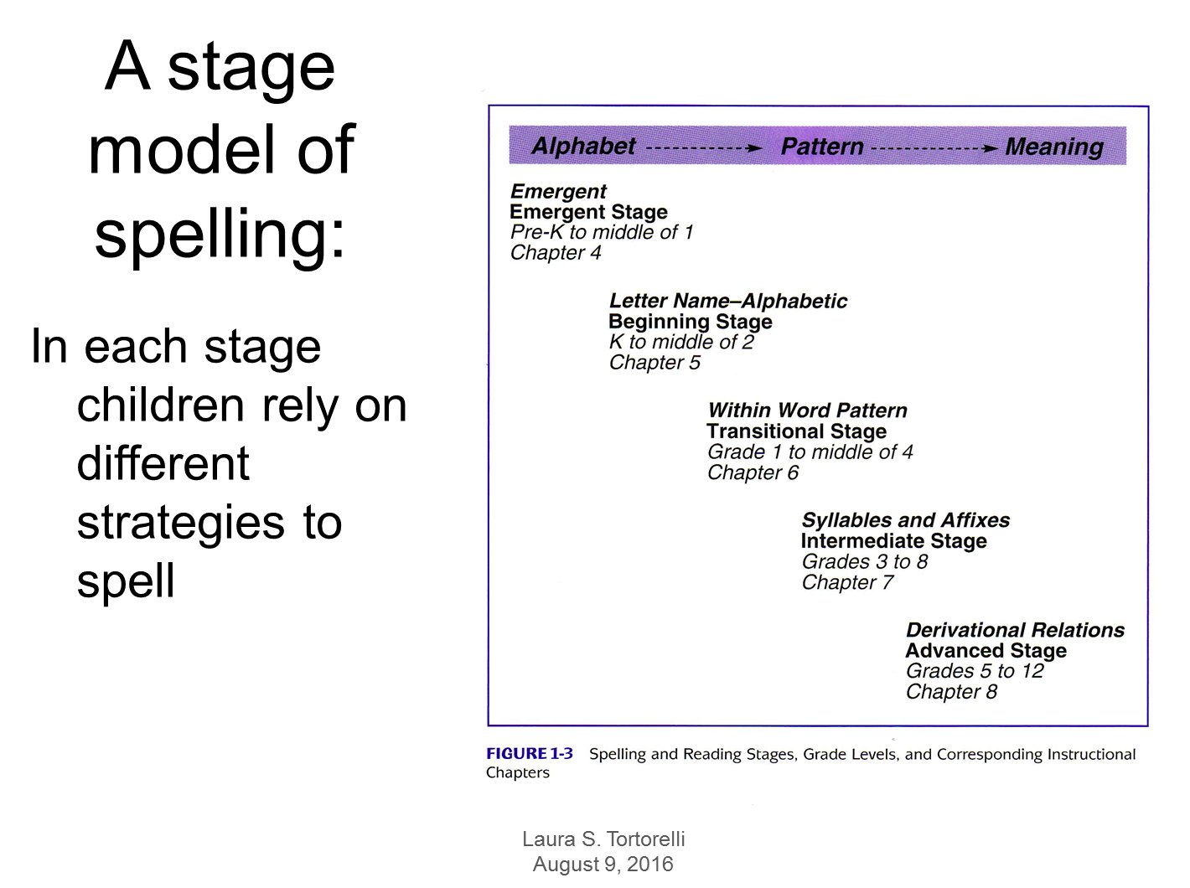


Slide 20
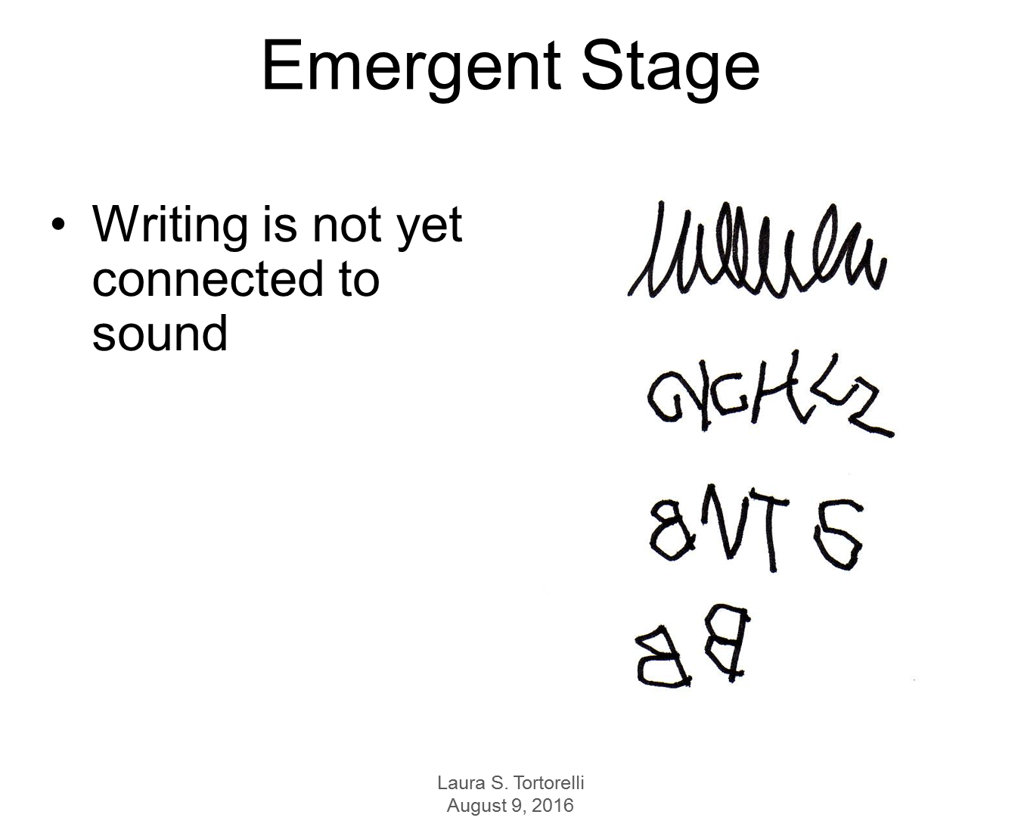

Slide 21
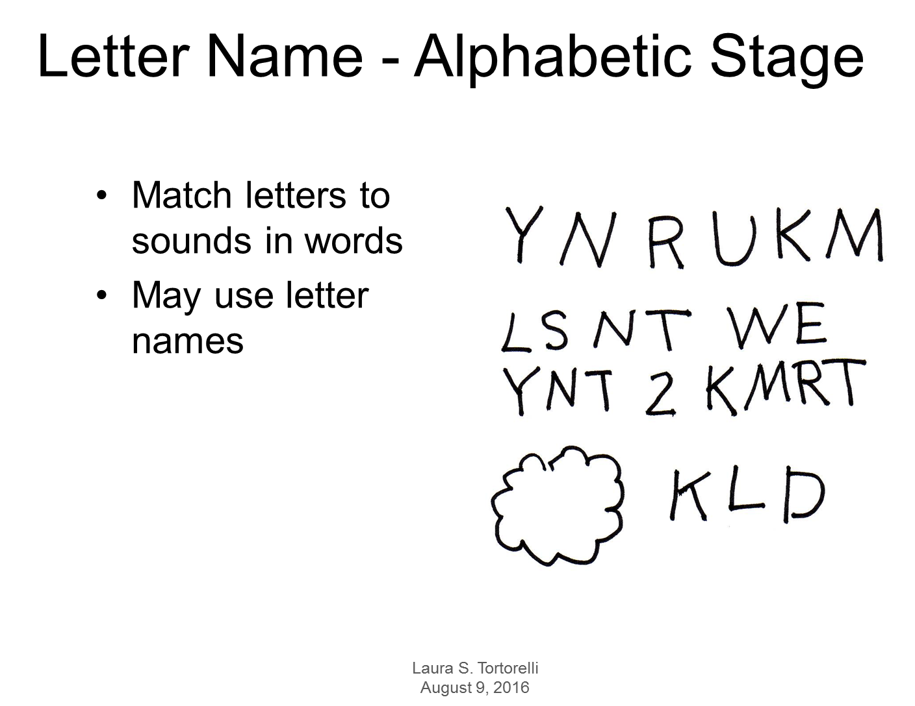

Slide 22
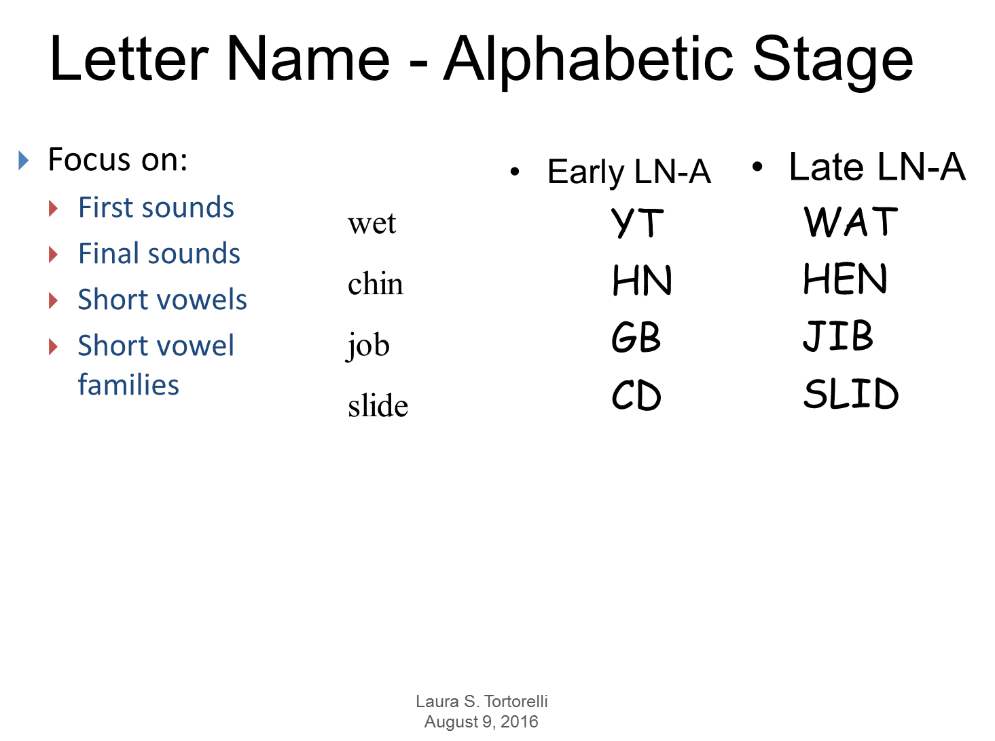

Slide 23
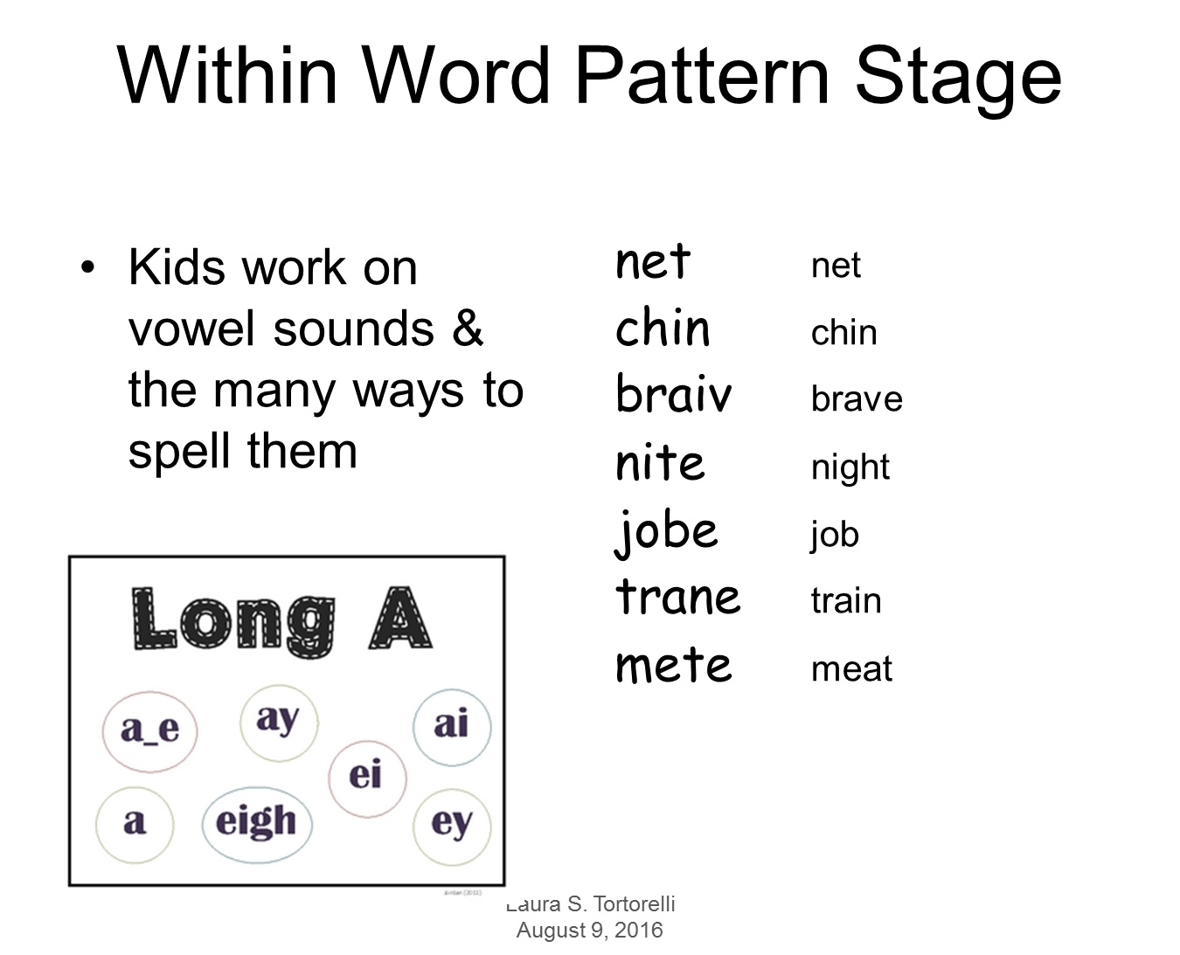

Slide 24
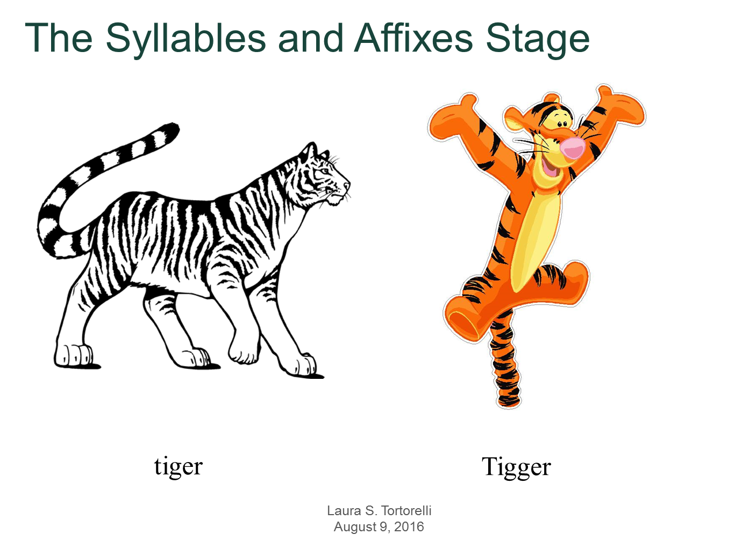

Slide 25
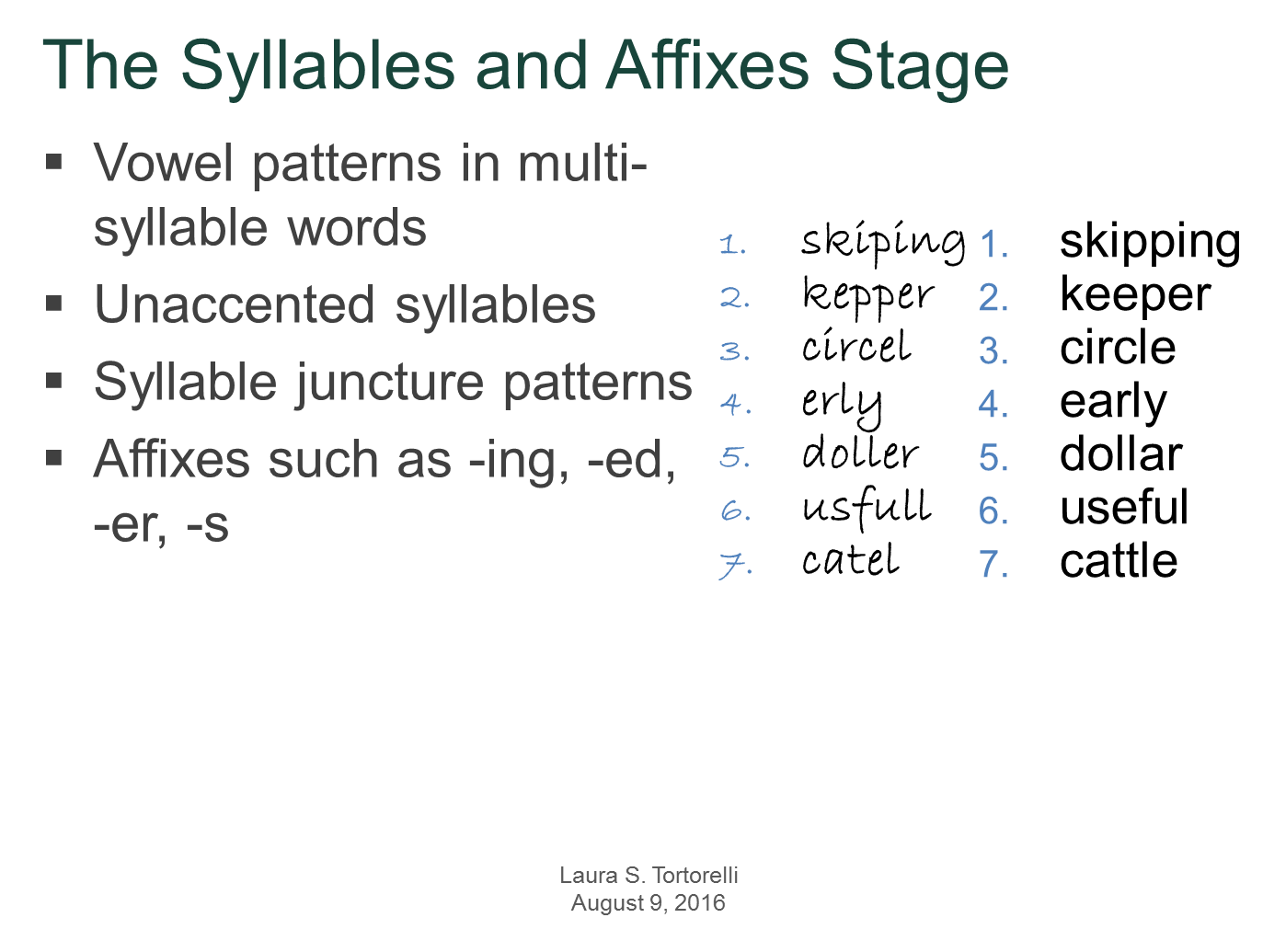

Slide 26


Slide 27
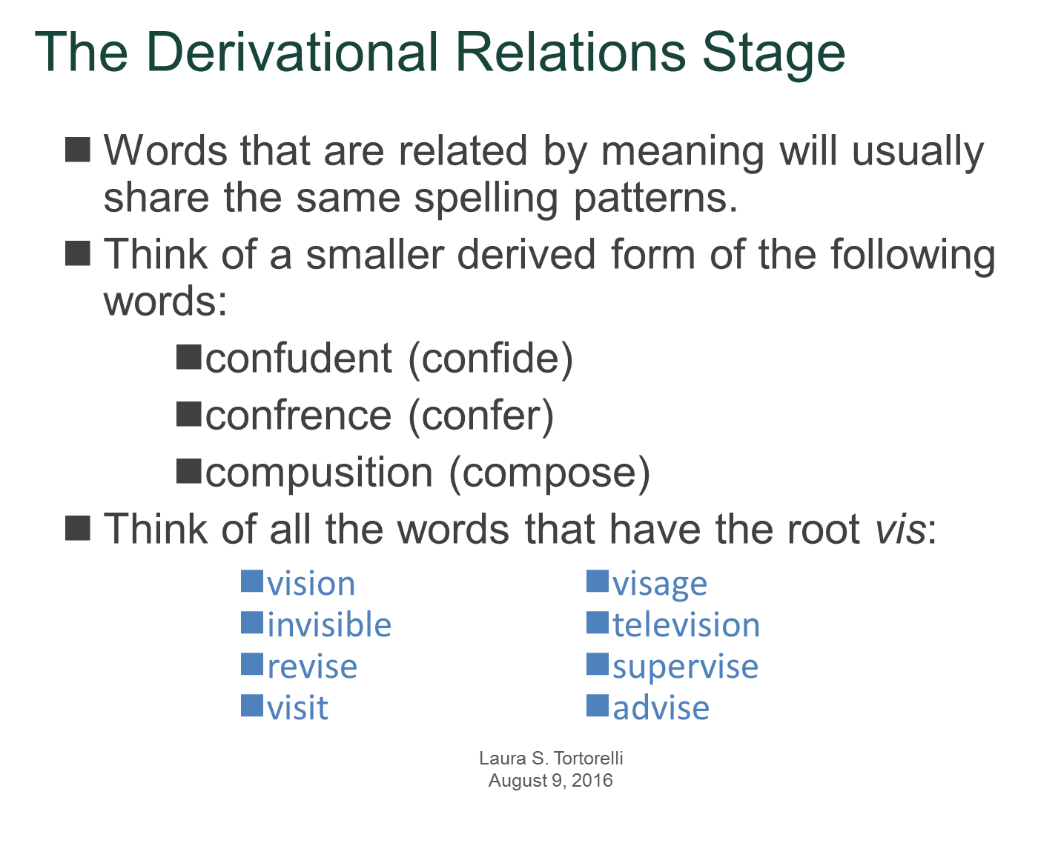

Slide 28
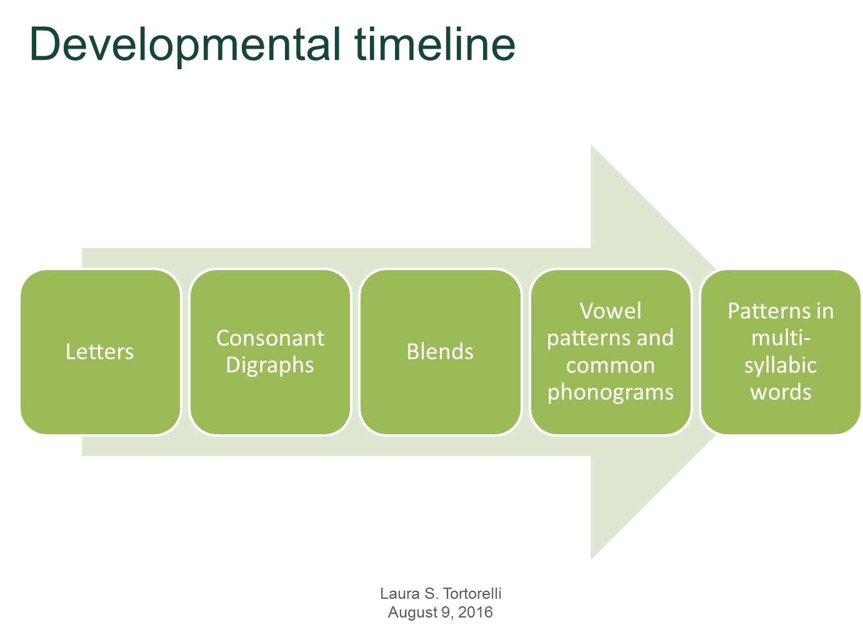

Slide 29

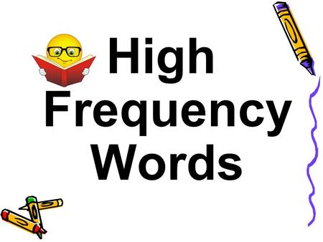

Slide 30
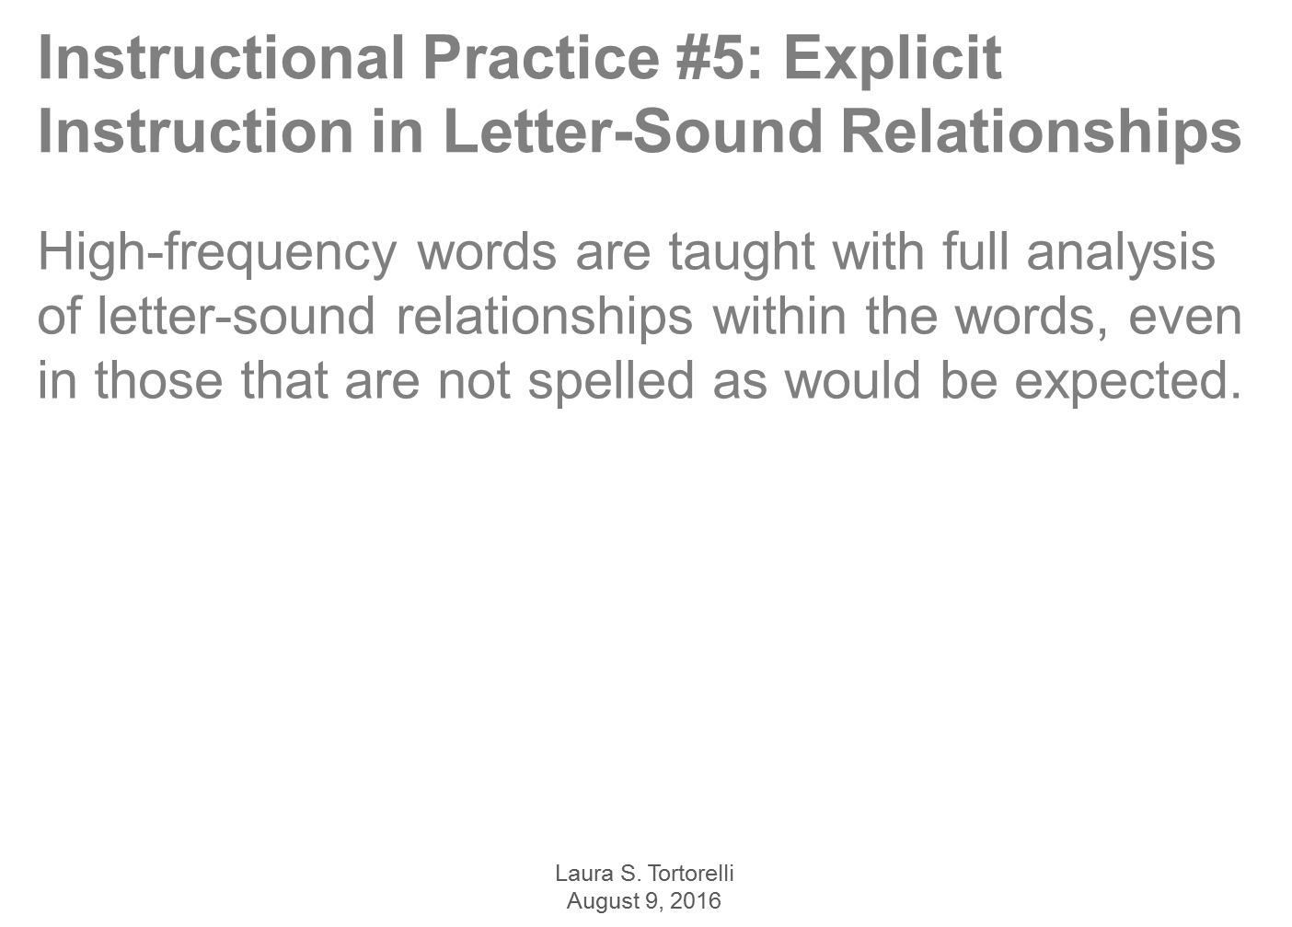

Slide 31
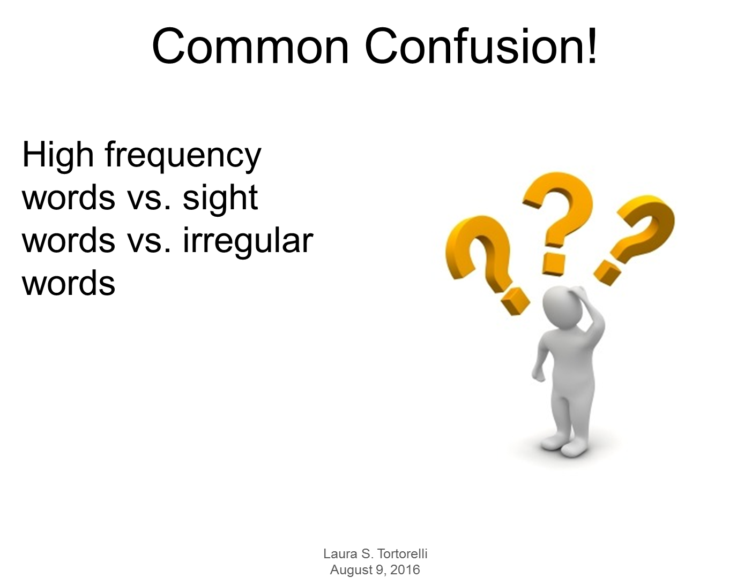

Slide 32
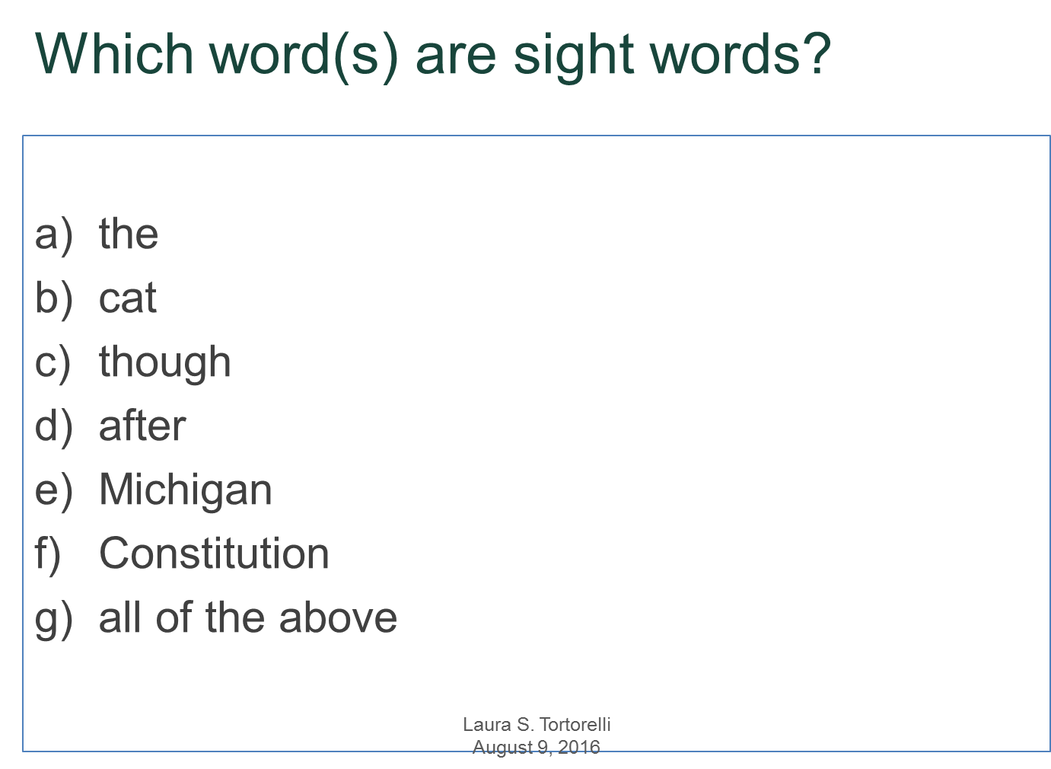

Slide 33
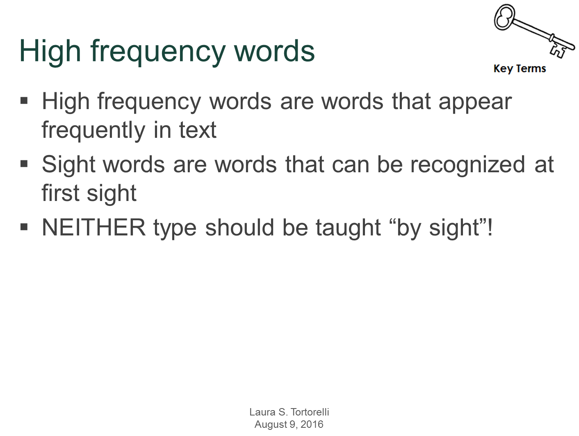

Slide 34
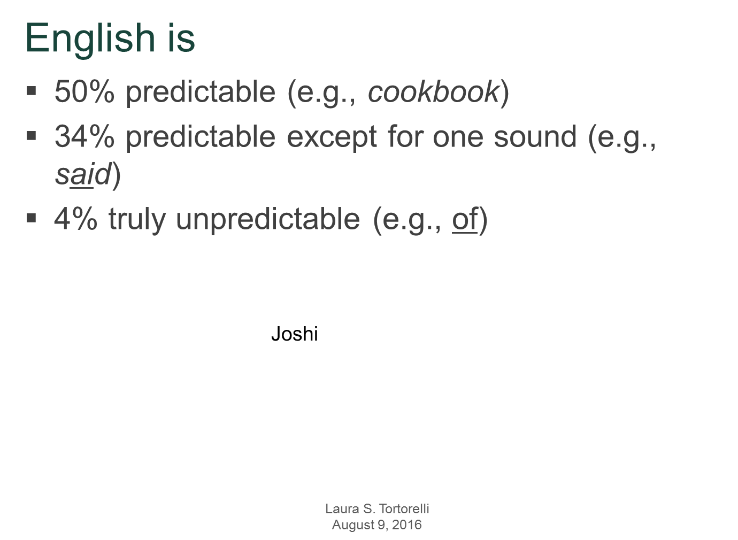

Slide 35

https://youtu.be/CYLefa3kFYs

Slide 36
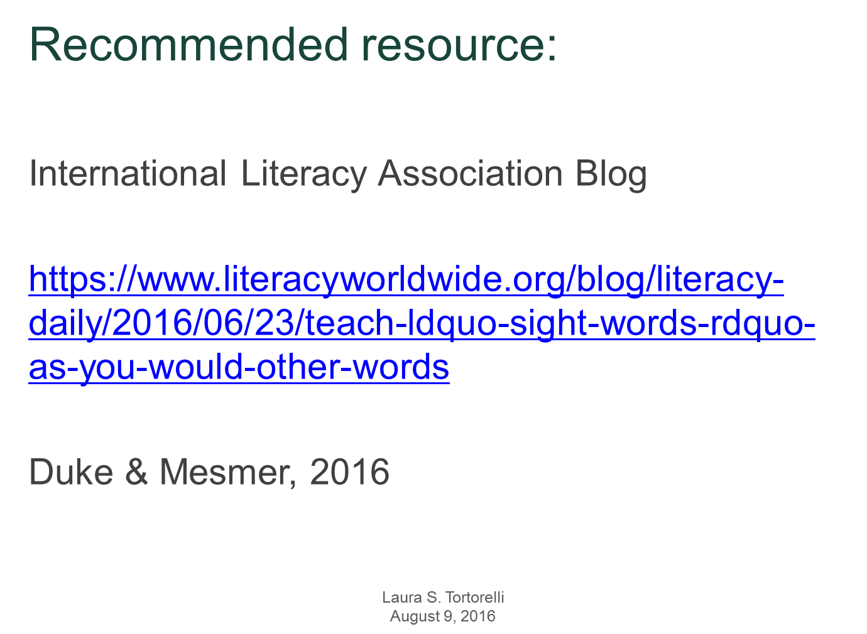

Slide 37
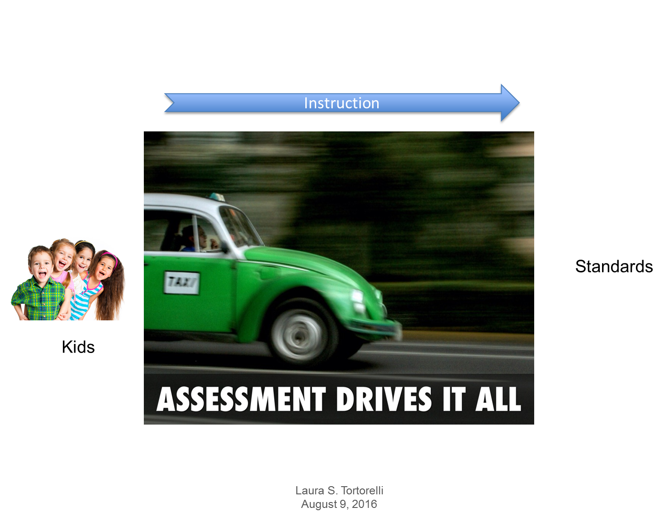

Slide 38
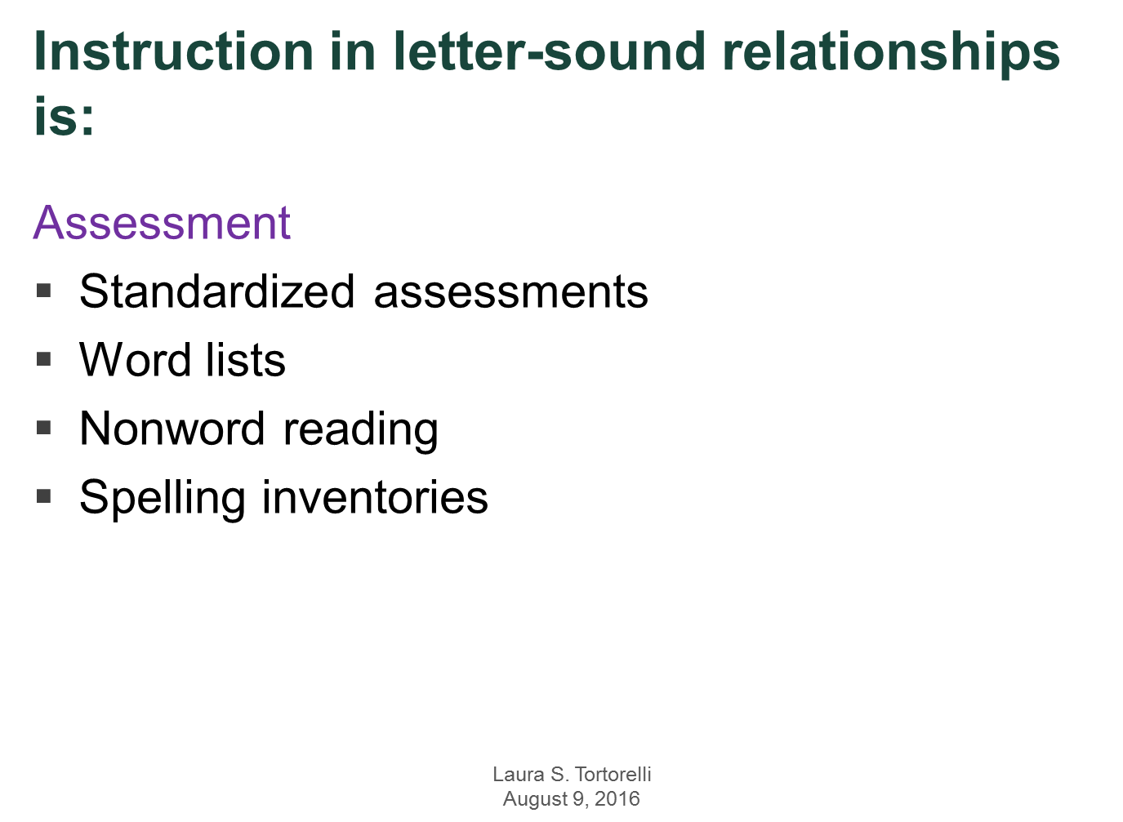

Slide 39
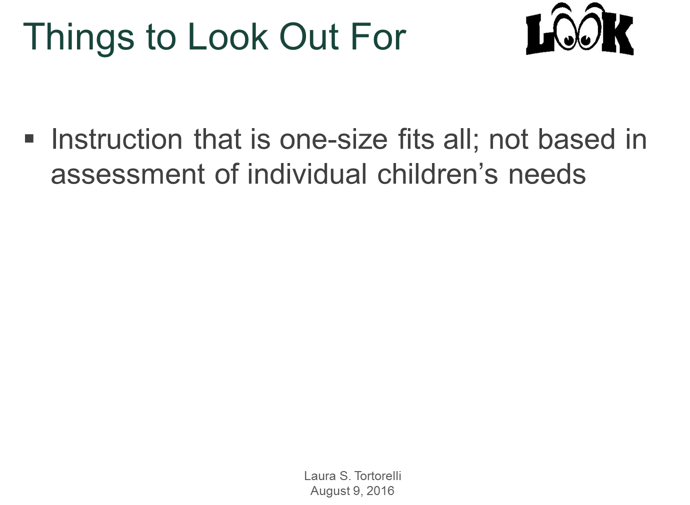

Slide 40
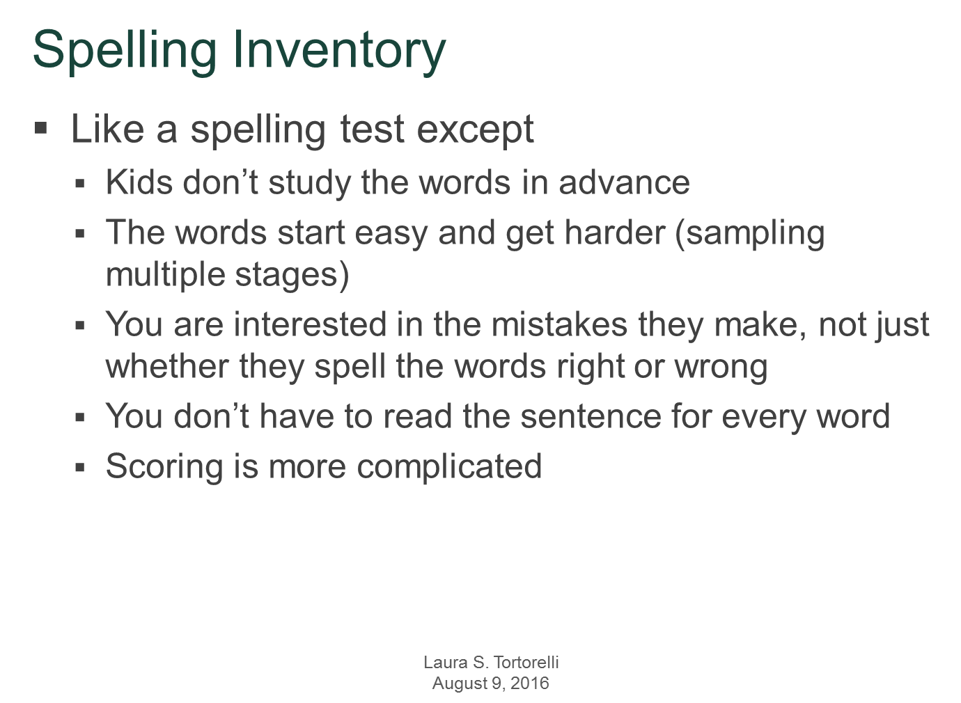

Slide 41
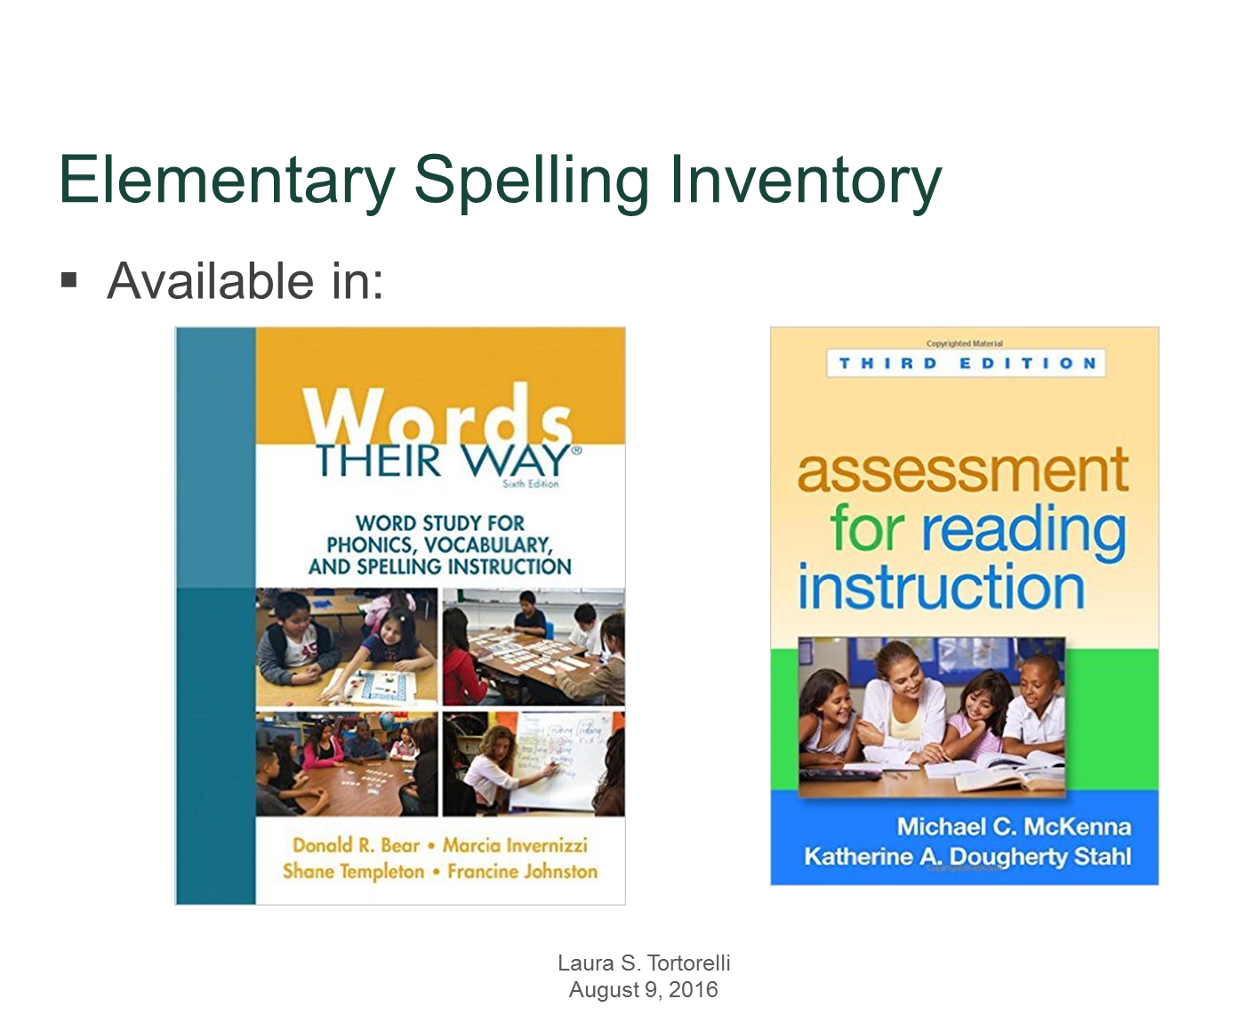

Slide 42
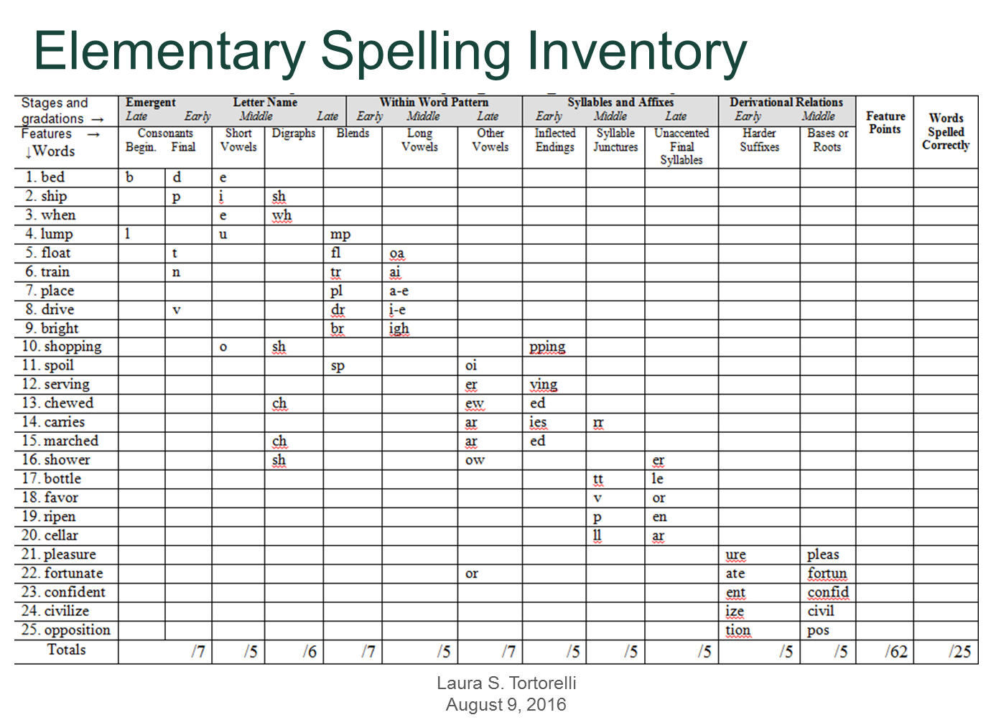
Let’s Review the Directions for how to administer the ESI
Let’s Practice Scoring Miguel

Slide 43
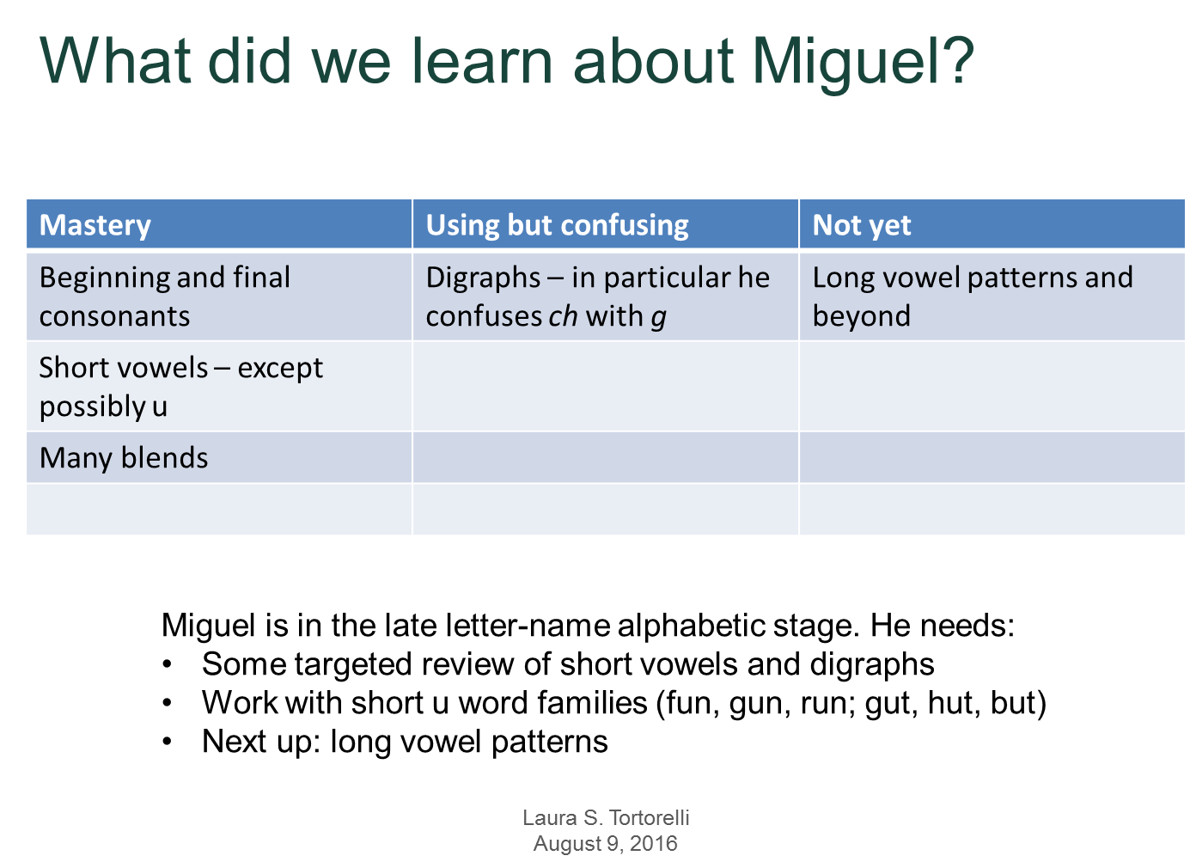

Slide 44
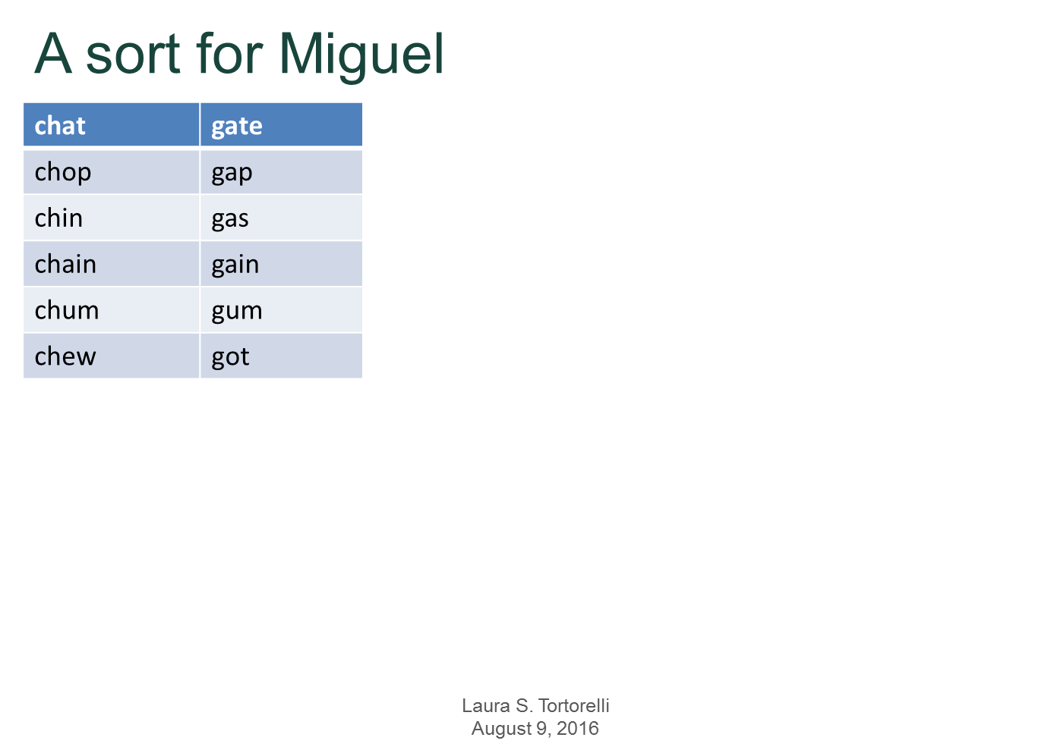

Slide 45
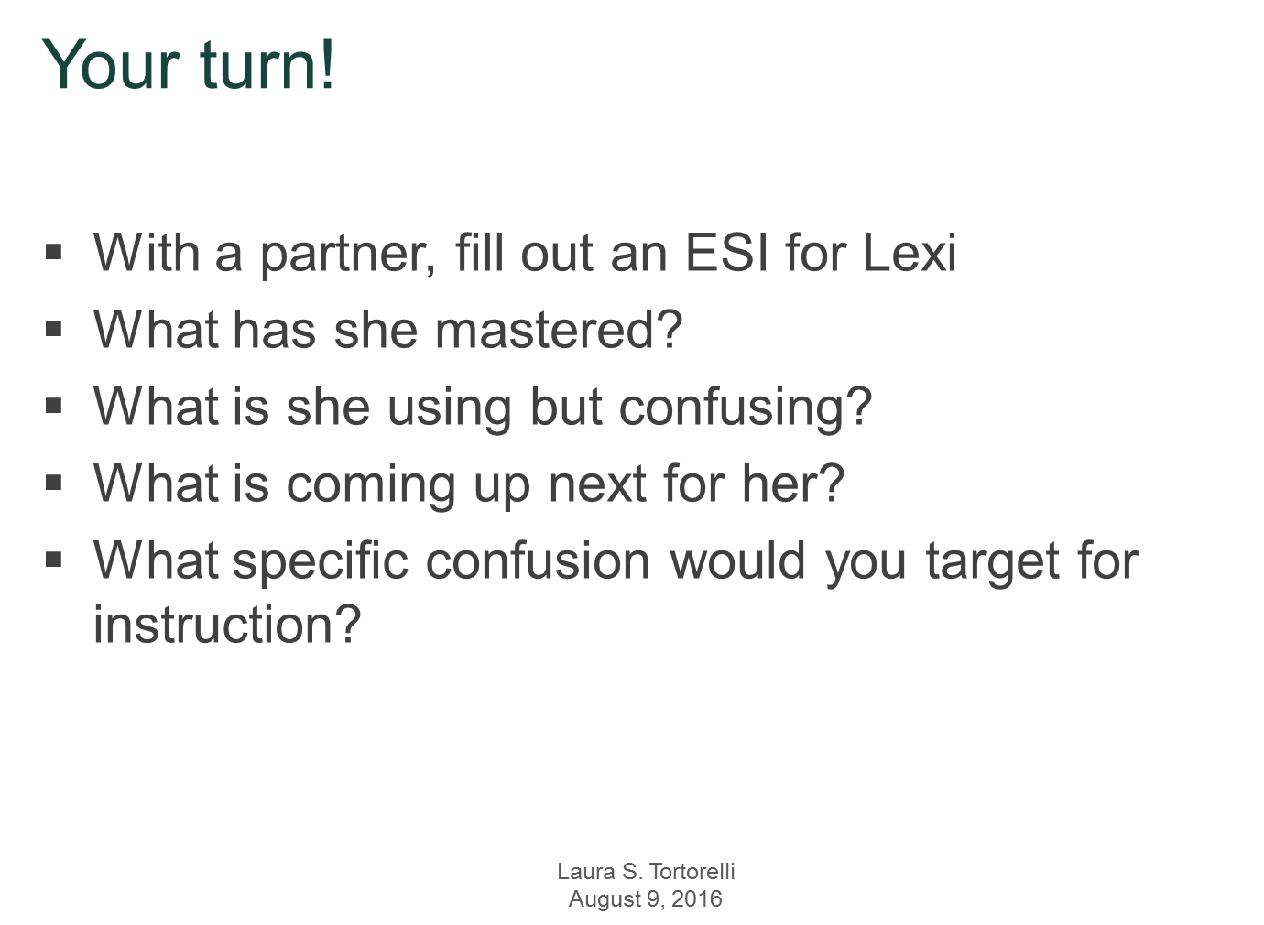

Slide 46
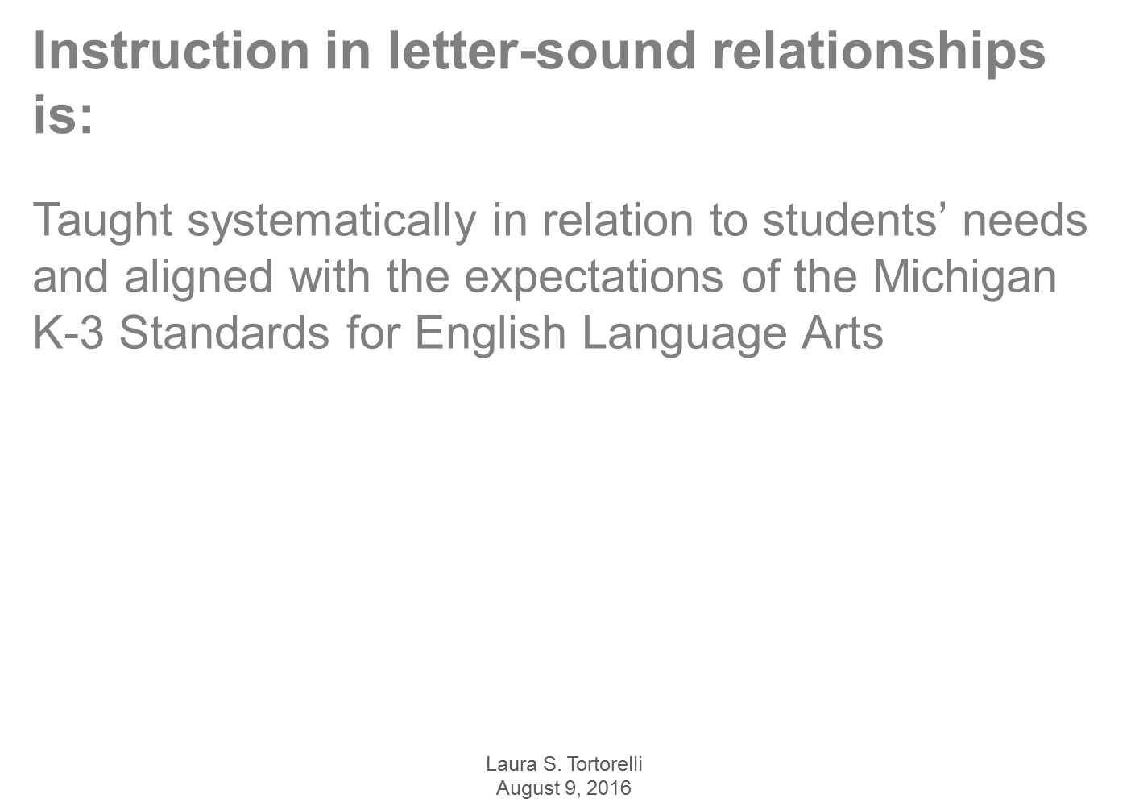


Slide 47
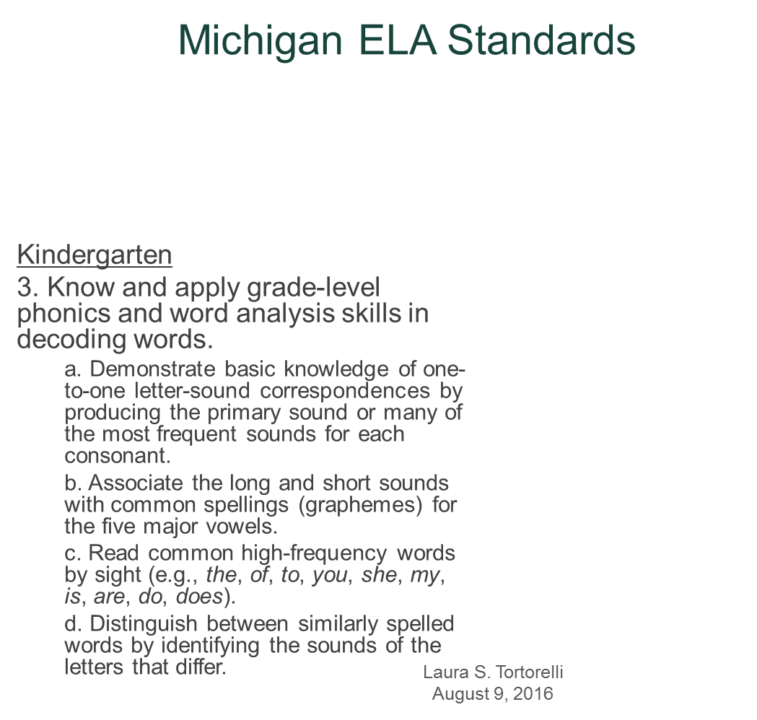

Slide 48
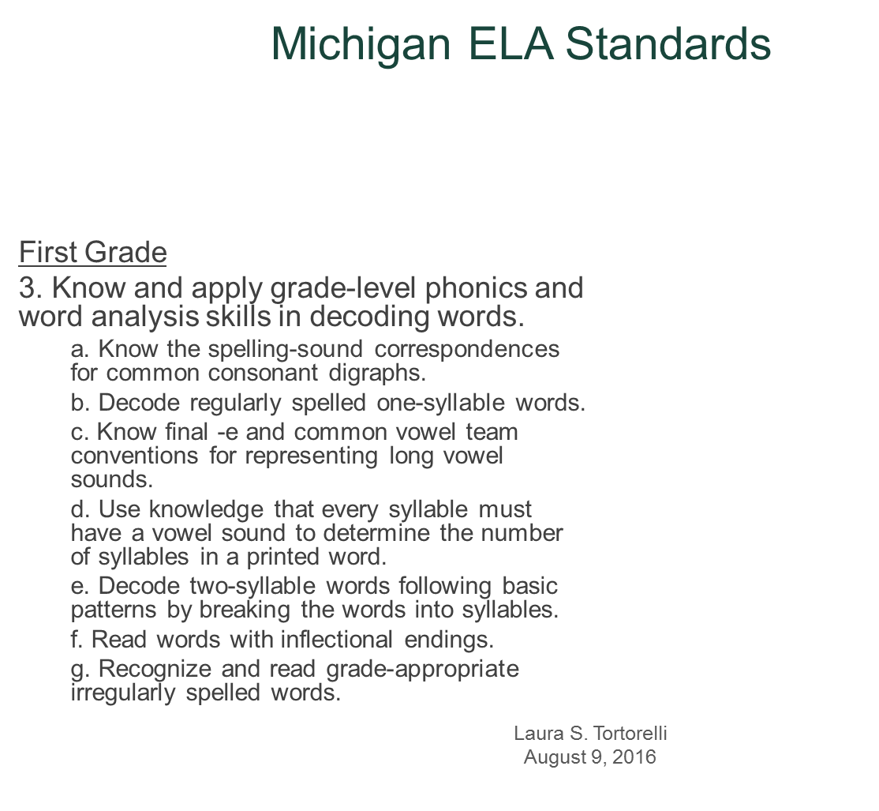


Slide 49
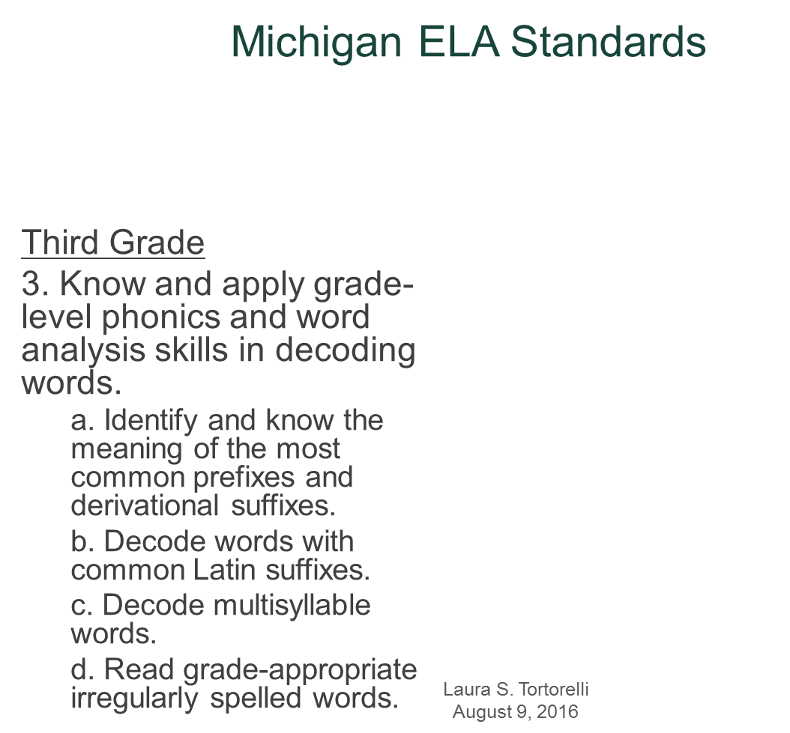

Slide 50
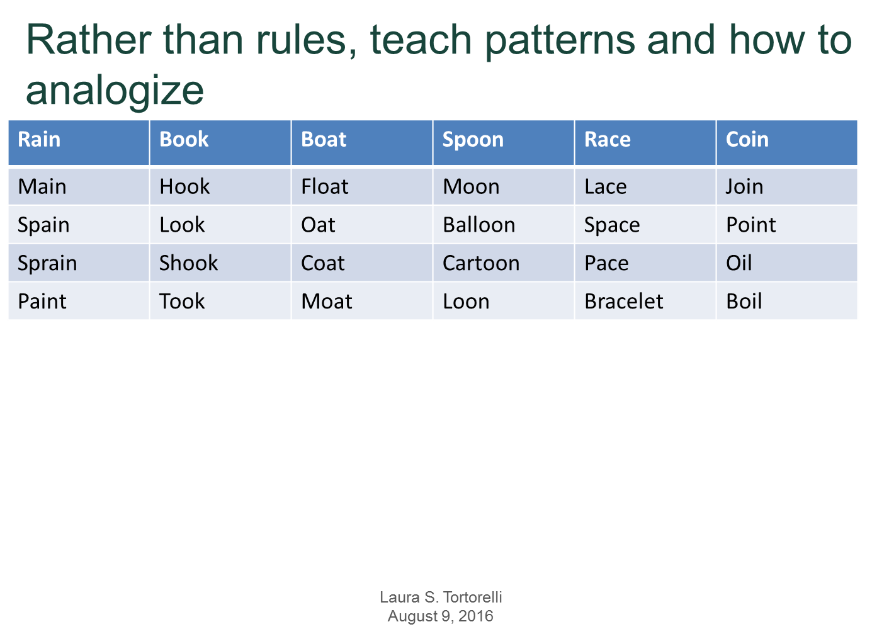

Slide 51
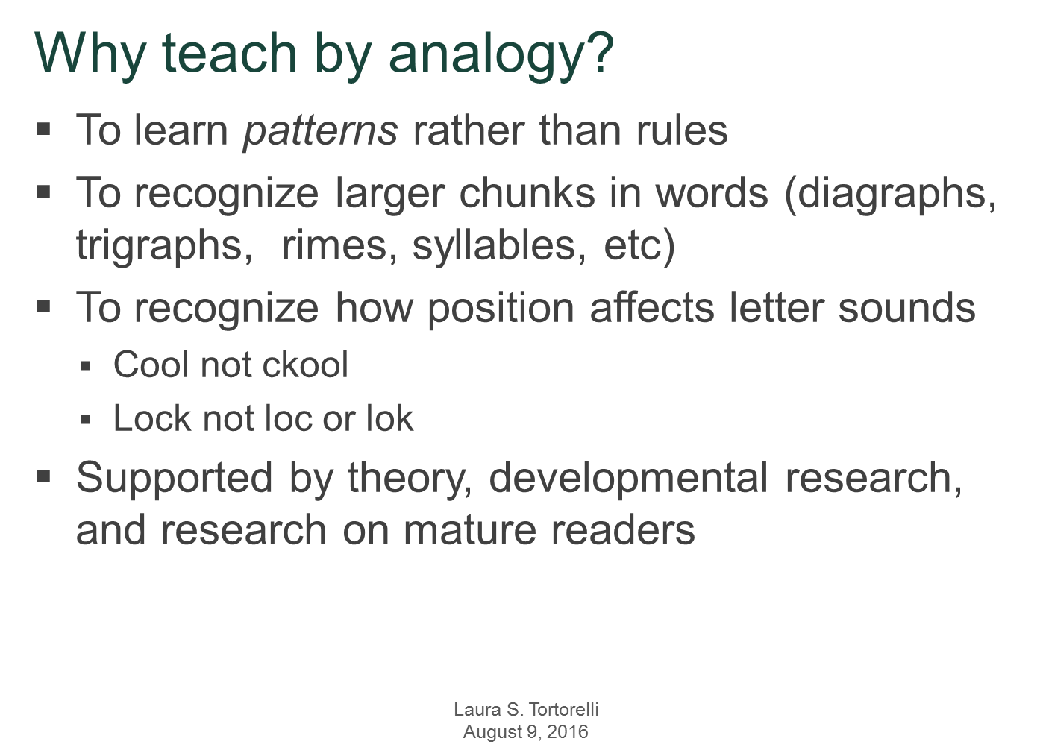

Slide 53


Review from Last Year’s Professional Learning

Slide 54
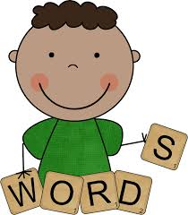
Word Work
Provides students with opportunities to investigate and understand the patterns in words.
Adds to our knowledge and curiosity of unique and interesting words
Helps us understand how words work
Benefits us to become better readers, writers, and spellers
Increases word and vocabulary knowledge
Notes:
Knowledge of these patterns means that students needn't learn to spell one word at a time.
Take, for example, the difference between "hard c" (as in cat) and "soft c" (as in cell). After collecting many words containing the letter "c," students discover that "c" is usually hard when followed by consonants (as in clue and crayon) and the vowels "a," "o," and "u" (as in cat, cot, and cut). In contrast, "c" is usually soft when followed by "i", "e," and "y" (as in circus, celery, and cycle).

Slide 55
Word Work – What Does it Look Like?
Students | Teacher
One person takes out materials of choice and sets up in a quiet location (desk or station) | Guided Reading Groups
Stay in one spot until time to return materials | Conferring
Work entire time
Try your best
Work on stamina
Work quietly
Get started quickly

Slide 56
Word Work
Experimenting with words and learning and practicing a spelling pattern
Word sorting- students sort words into categories
  Comparing and contrasting features in words.
  Making and breaking words with magnetic letters, dry erase boards, picture sorts, play-doh, Wikki Stix, stamps, markers
  Name work, alphabet letters/sound work, phonological awareness activities
Reading/Writing words
Focus on sight words, patterns, vocabulary words depending on student’s level
Word Study Program – Words Their Way

Slide 57
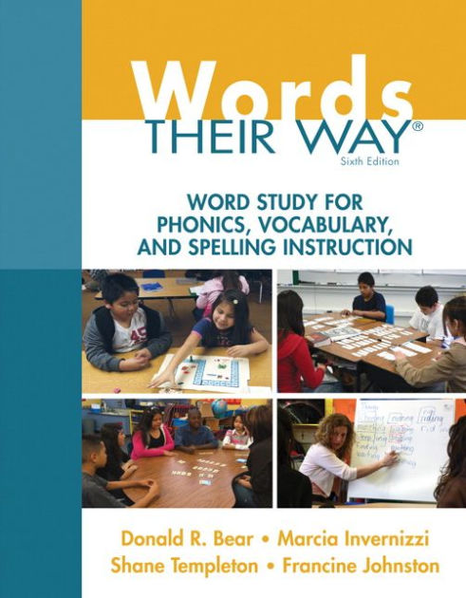

Getting Started
Informal Observations to Assess Orthographic Knowledge
Administer a Spelling Inventory
  Primary Spelling Inventory – K-3 – Emergent to late within word pattern
  Elementary Spelling Inventory – 1-6 – Letter name to early derivational relations
Score and Analyze the Spelling Inventories – Determine a Developmental Stage
Group Students for Instruction – Classroom Composite Chart

Slide 58

The role of word study
The simple process of sorting words into categories is the heart of word study
Categorizing is a fundamental way that humans make sense of the world
It allows us to find order and similarities among various objects, events, ideas, and words that we encounter
When students sort words, they engage in the active process of searching, comparing, contrasting, and analyzing
Word sorts help student organize what they know about words and form generalizations that they can then able to new words they encounter in their reading or spell in their writing

Slide 59
Teaching New Word Knowledge through Sorting
  Word sorting offers the best of both constructivist learning and teacher-directed instruction
  Begin by “stacking” the “deck” with words that can be contrasted by sound, pattern or meaning
  During sorting, students will discover generalizations about how the English spelling system works
  Rather than simple memorizing 20 words each week for a spelling test, students have the opportunity to construct their own word knowledge that they can apply to reading and writing
  In addition to learning how to spell, read, understand, and use new words, students develop productive habits of mind (Marzano, 1992)

Slide 60
Teaching Phonics through Sorting – P.52
  One central goal of word study is to teach students how to spell and decode new words to improve their word recognition speed in general
  To accomplish this goal we teach students how to examine words to learn the regularities that exist in the spelling system
  Picture and word sorts are designed to help students learn how and where to look at and listen to words
  Sorts are hands-on and manipulative

Slide 61
Teaching Phonics through Sorting – P. 52 - continued
  The process or sorting requires students to pay attention to words and to make logical decisions as they place each one in a column
  Students work with words or the name of pictures that they can already pronounce. In this way, processing words from the known to the unknown while sorting through a set of cards, children concentrate on analyzing sounds or patterns within each word
  Word sorting offers an analytic phonics approach – using known words, students are asked to examine their parts listening for sounds, looking for patterns, or thinking about meaning
  Sorting does not rely on memorizing or reciting rules prior to understanding the underlying principles. During sorting, students determine similarities and difference among feature as they use higher-level critical thinking skills to make categorical judgments.
  Consider the ancient proverb: “I hear and I forget, I see and I remember, I do and I understand.”

Slide 62
Types of sorts – P. 52 - 54
Sound Sorts – The first layer of English orthography – sorts by rhyme, initial sounds, consonant blends or digraphs, rhyming word families, or vowel sounds
Pattern Sorts – Use the printed form of the word to sort by visual patterns or letter sequences – word families, vowel word patterns
Meaning Sorts – focus of a sort is meaning
  Concept Sorts – sorting objects, pictures or words by concepts of meaning is a good way to link vocabulary instruction to student conceptual understanding
  Spelling-Meaning Sorts – students see that meaning influences the spelling of words when they first encounter sound alike homophone pairs – when you teach through homophones through sorting, students expand their vocabularies and learn spelling patterns at the same time

Slide 63

Teacher-Directed Closed Sorts – P.55
The highest level of support and explicit instruction is offered in teacher-directed closed sorts
Define the categories in advance using key words and/or headers and make it clear how to conduct the sort
Explicitly model sorting the words
After modeling several words gradually release the task to the students’ control as they finish the sort under your supervision
After sorting, the students discuss the characteristics of the words in each column and develop a generalization based on the selected feature
The teacher-directed sort is the most commonly used approach to introduce a new sort to a group, providing a model of direct instruction that is explicit and systematic

Slide 64
Teacher-Directed Closed Sorts – Lesson Plan P.55-56
1. Review the words – look over the words or pictures for items that are potentially difficult to identify or that may be unfamiliar to students
2. Establish the categories – use open ended questions such as “What do you notice about these words?” or “How might we sort these words?”
3. Model several words into each category and explain why you are sorting – “We are going to listen for the vowel s sound in the middle of these words and decide if they sound like map or like duck. I’ll do a few first.”
4. Turn the task over to students to finish the sort – Display the rest of the pictures or words, pass them out, or continue to hold them up one at a time.

Slide 65
Guess My Category: A teacher-Directed Sort – P.58
When students are comfortable with sorts, you can introduce any new area of study with a collection of objects, words, or pictures in a variation of the teacher-directed sort
Set up key words or pictures as in a closed sort but do not offer and explanation of the categories
It is your students’ job to develop hypotheses about how the things in each category are alike
Begin by sorting two or three pictures or words into each group

Slide 66
Guess My Category: A teacher-Directed Sort – P.58-Continued
Pick up the next picture and invite someone to guess where it will go
Continue doing this until all of the pictures or words have been sorted
Check the sort, and guide a reflection as you would for the teacher-directed sort
Particularly useful in small groups for exploring content-specific vocabulary while also stimulating creative thinking

Slide 67
Student-Centered Sorts – P. 58-59
As students become sorting pros, student-centered sorts increase the cognitive demand and can reduce the amount of teacher-directed group time
Students are given their words for the week on Monday morning and they sort their words independently in anticipation of the categories they will be sorting later in the teacher-directed groups
Closed sorts can be used the provide the headers and key words students need to complete the sort on their own
Open sorts demand the highest level of independent effort and thought because students are not given any clues to the categories
Even with student-centered sorts you should still meet with students individually or in a group to discuss the sort and check it for accuracy
Student-centered sorts are diagnostic in nature because they reveal what students know when they work independently

Slide 68
Extension and follow-up Routines – P.61-65
Repeated Sorts
Buddy Sorts
Blind Sorts
Writing Sorts
Blind Writing Sorts
Speed Sorts
Word Hunts
Draw and Label
Cut and Paste
Games

Slide 69
Preparing your sorts for cutting and Storing
Copies of prepared word sheets or picture sheets are available in Words Their Way supplements for each stage.
They can also be created by hand using templates and pictures in the book, the Create Your Own feature in the PDToolkit, or by using the tables format on your computer and setting all margins at 0 inches.
Sorts for Teacher Modeling – You will need your own set of words that students can see as you direct a sort – in small groups, you may simple use the same cut-out words students have as you model on a table. For larger groups you may want to model sorts using enlarged pictures or word cards in a pocket chart.

Slide 70
Scheduling Time for Word Study – P. 71-80
Word Study as in Integrated Part of the Reading Group
Separate Word Study Groups in a Circle-Seat-Center Rotation
Word Study Block
Individualized Word Study in Intervention Settings

Slide 71
Getting Started with word Study – P. 80-81
Begin with the whole group and teach the routines
Teach students how to talk about the sorts
Begin to differentiate
Introduce student-centered sorts

Slide 72
Weekly Schedule - Sample – P. 76
Monday | Tuesday | Wednesday | Thursday | Friday
Introduce Sort and supervise individual sort | Re-sort Record sort and reflect First speed sort | Re-sort Blind sort WS notebook assignments | Re-sort Word hunt Second speed sort | Assessment and games (Games continue into the next week as seat or center activities)
Homework: Re-sort | Homework: Re-sort and writing sort | Homework: Blind sort | Homework: Re-sort and blind writing sort
Monday – Picture Sort
Tuesday – Draw and Label
Wednesday – Cut and Paste
Thursday – Word and Picture Hunts
Friday – Game Day and Assessment

Slide 73
“Offset” Weekly Plan – Sample – P. 78
 | Day 1 | Day 2 | Day 3 | Day 4 | Day 5
Lowest Group | Meet with teacher | Re-sort Record Sort | Blind sort WS notebook | Re-sort Word hunt | Testing and Games
Middle Group | Sort Independently | Meet with teacher Record sort | Blind sort WS notebook | Re-sort Word hunt | Testing and games
Highest Group |  | Sort independently | Meet with teacher Record sort | Re-sort Word hunt | Testing and games or blind sort and test on next day
If you do not want to take a large block of time on Monday to do all the introductory small-group sorts, spread them across the week by meeting with one group a day on Monday, Tuesday, and Wednesday, with each group’s independent work operating on an “offset” schedule.

Slide 74
Integrated Word Study into Reading, Writing, and the Language Arts Curriculum – P. 82-83
Generalize to new words
Dictated or silly sentences
Relations among related relatives
Cover and connect
Word walls
Word displays

Slide 75

Assessment – Set Goals and Monitor Student Growth Over Time – P. 41-47
Fridays/Day 5 – Assessment at this level is primarily informal as the teacher watches for automaticity and accuracy during sorting and how well students label pictures or use initial sounds in writing
Word Study Notebooks – Composition books with expectations on inside cover – overall grade
Periodically give a review test of unit test – without asking students to study – to check for retention
Spelling Inventories – Students may be given the same spelling inventory up to three times during the year to assess progress and to determine whether changes need to be made in groups or instructional focus – using the same inventory shows progress over time

Slide 76
Assessment – Set Goals and Monitor Student Growth Over Time – P. 41-47
Spell Checks – Mini-inventories that can be used over shorter periods of time to monitor students’ generalizations of specific features. Spell Checks serve several purposes:
  to fine-tune placement
  as a pretest for a feature or until of student before instruction to determine what students already know
  as a posttest after instruction to determine what students have learned, and
  as a delayed posttest administered several weeks after instruction to determine what students have retained over time
Like inventories, spell checks are organized by sequential groups of phonics features and spelling patterns, but each spell check includes more features and more words for each feature within a stage
Spell checks can be used to monitor progress and refine the focus and pacing of instruction for individuals or small groups

Slide 77
Assessment – Set Goals and Monitor Student Growth Over Time – P. 41-47
Traditional Spelling Tests – but student specific – if you have two or three groups, simply call one word in turn for each group
  Students will recognize the words they have studied over the week and rarely lose track
  It is not necessary to call out every word studied during the week; 10 is typically enough
  You can call out bonus or transfer words that were not among the original list to see whether students can generalize the orthographic principles to new words – generalization is emphasized, as opposed to rote memorization
  It is particularly effective to conduct the spelling test as a writing sort, having students write each word as it is called out into the category where it belongs – award one point for correct category placement and one point for correct spelling
Dictation/Dictated Sentences – analyze patterns/spelling

Slide 78

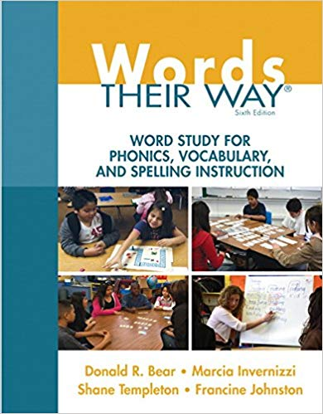
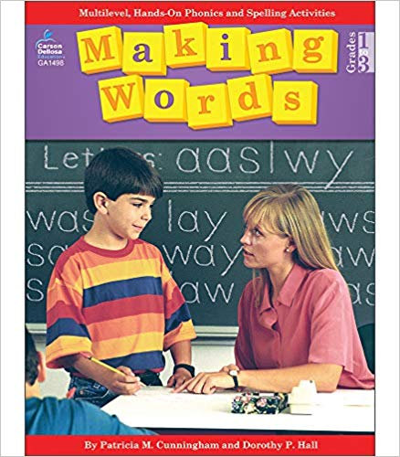

Collaboration and Planning Time
Please take some time to explore resources – books and online materials
http://pdtoolkit.pearsoncmg.com
Begin to plan/discuss word study in your classroom

Slide 79

Thank you!!
Thank you as always for a great day of learning and collaboration and thank you once again for all you do for your students!

